Slide 1


IMPROPER INTEGRALS

Slide 2
OBJECTIVES
At the end of the lesson, the student should be able to:
• Learn what improper integrals over unbounded intervals are
• Learn what improper integrals of unbounded integrands are
• Brieﬂy discuss the comparison test.

Slide 3
Geometrically, an improper integral represent the signed area of an UNBOUNDED region under a graph.
Two types of improper integral:
Deals with UNBOUNDED INTERVAL
Deals with an UNBOUNDED INTEGRAND

Slide 4
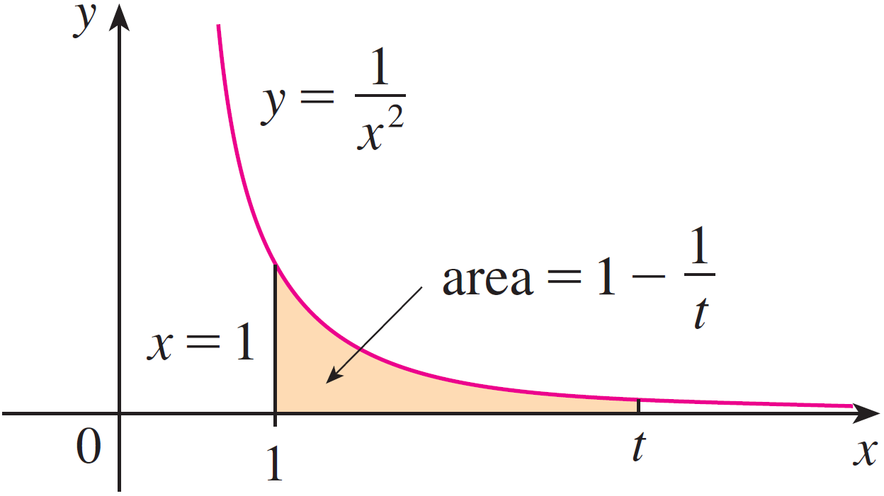
TYPE 1: INFINITE or UNBOUNDED INTERVALS
A region is said to be unbounded if there is no ﬁnite radius circle that contains the regions entirely.
Consider the infinite region S that lies under the curve y = 1/x2, above the x-axis, and to the right of the line x = 1. You might think that, since S is infinite in extend, its area must be infinite.
However, this is not true.

Slide 5
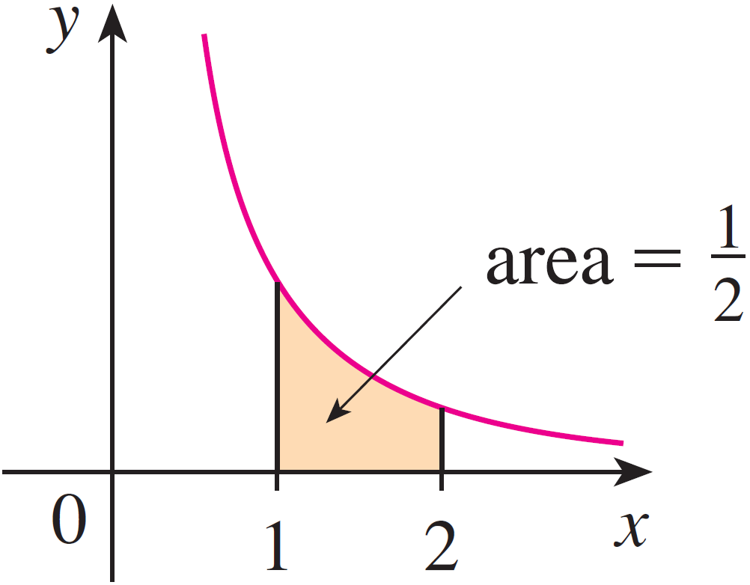
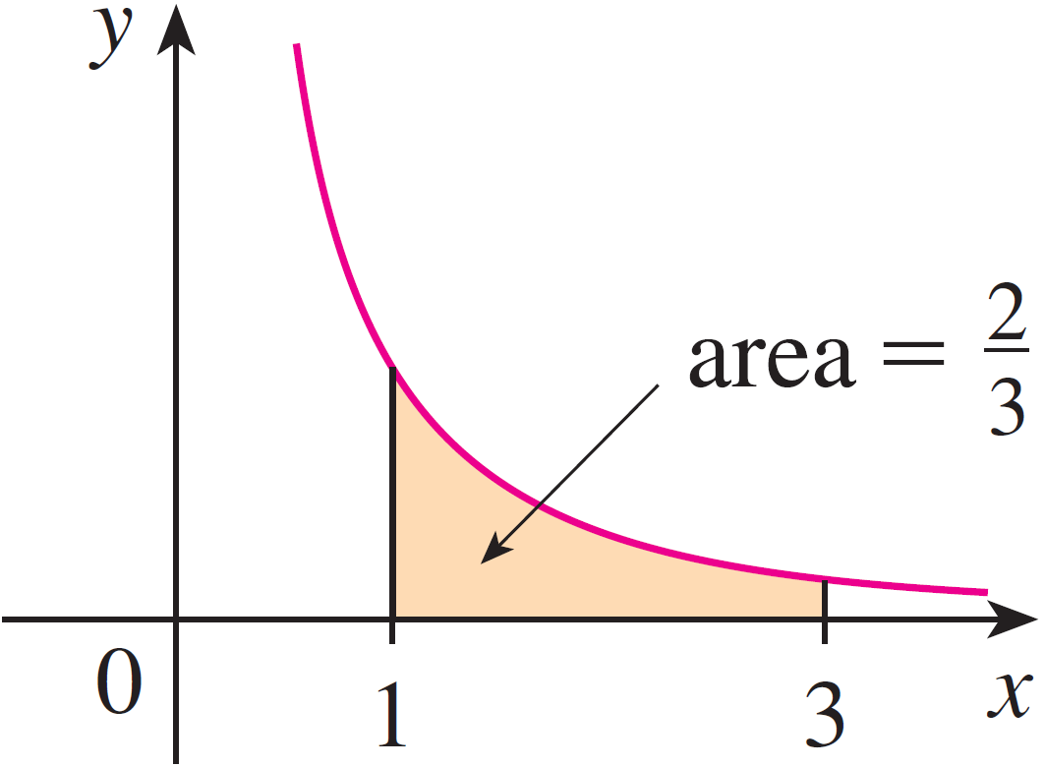

Slide 6
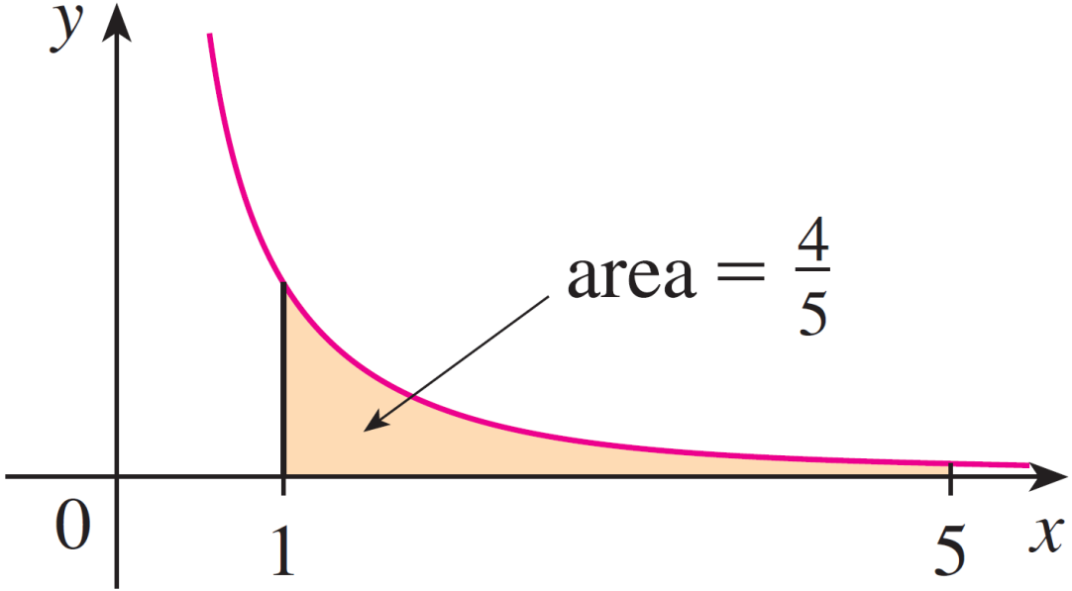
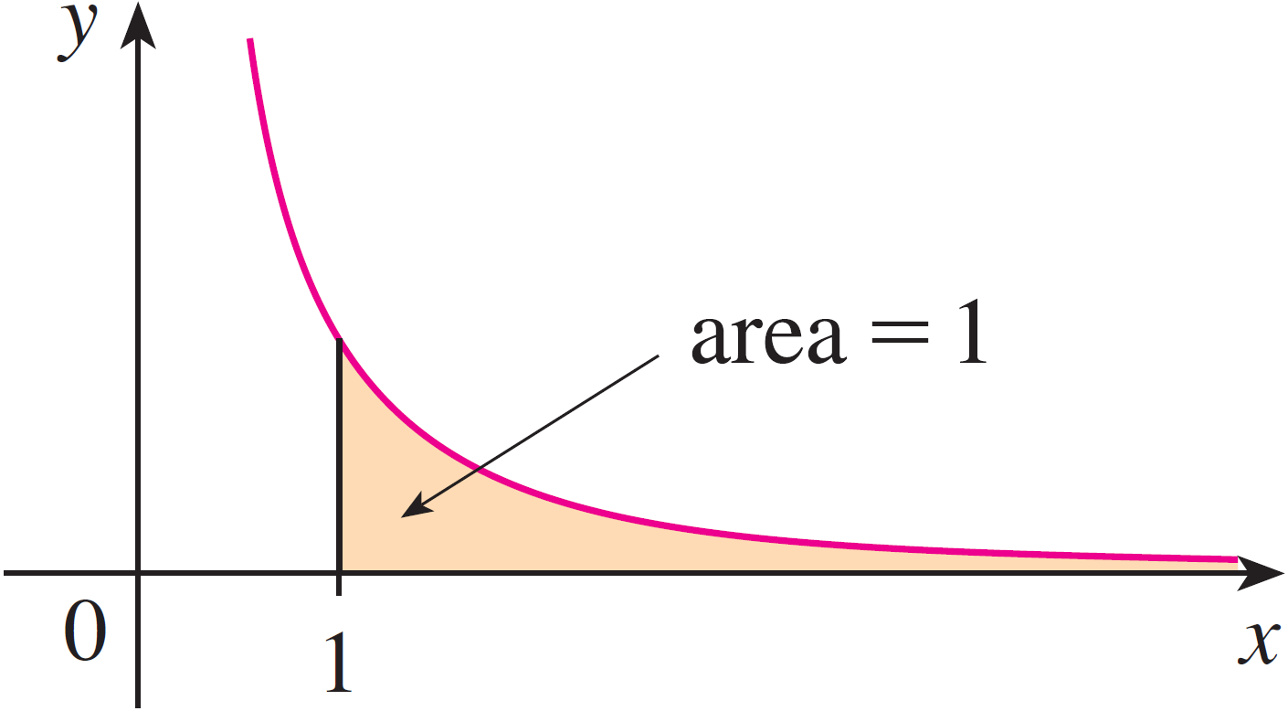
Notice that A(t) < 1 no matter how large t is chosen.

Slide 7
So, this is how we will deal with these kinds of integrals in general. We will replace the infinity with a variable (usually t), do the integral and then take the limit of the result as t goes to infinity.

Slide 8
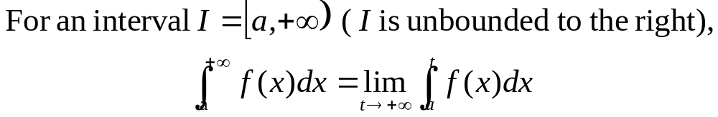
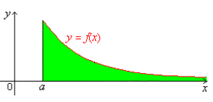
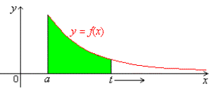

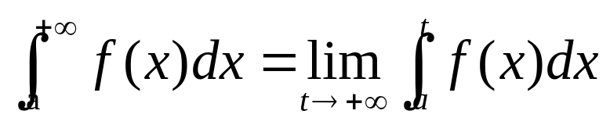
DEFINITION
We define the improper integral of a continuous function f(x) over an unbounded interval I as follows:

Slide 9
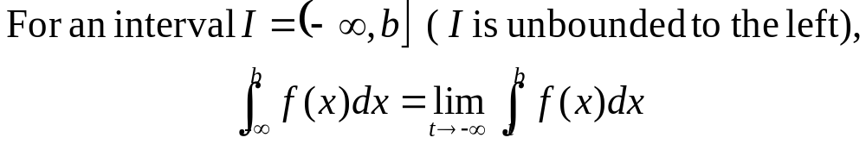
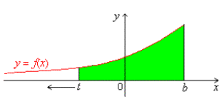


Slide 10
In each case, if the limit exists, then we say that the improper integral converges or is convergent; otherwise we say that it diverges or is divergent. If the limit is +∞ or -∞, we sometimes emphasize that the improper integral diverges to positive infinity or negative infinity.
An improper integral is defined as the limit of a proper integral.

Slide 11


Determine if each of the following improper integrals converges.
Sketch a graph in each case.

Slide 12
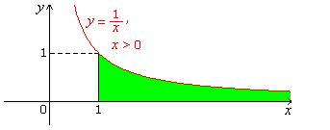




Slide 13
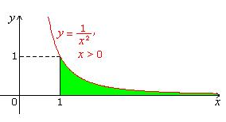




Slide 14
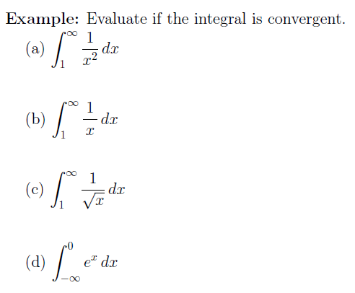

Slide 15

TYPE 2 - UNBOUNDED INTEGRANDS
The region under a graph may be unbounded even if it is over a bounded interval.
For example, a function may be continuous on an interval except at an endpoint, where it blows up and become undefined.
DEFINITION
We define the improper integral of a continuous
function f(x) over a bounded half-open interval I as follows:

Slide 16
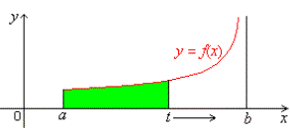


Slide 17



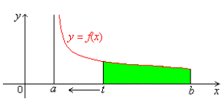


Slide 18


Determine if each of the following improper integrals converges.
Sketch a graph in each case.

Slide 19
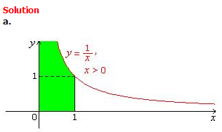



Slide 20
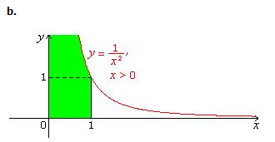




Slide 21
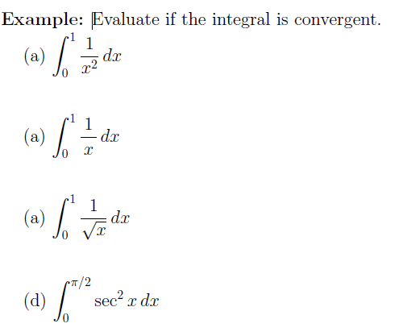

Slide 22
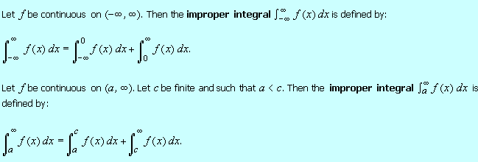
IMPROPER INTEGRALS OVER OPEN INTERVALS

Slide 23
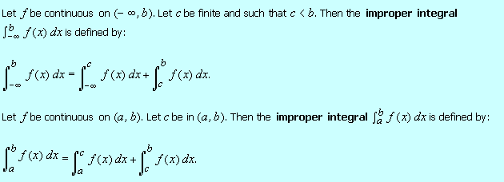
In each case, the improper integral on the left-hand side converges iff both the basic-type improper integrals on the right-hand side do.

Slide 24
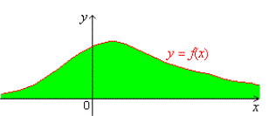

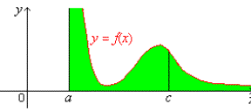

IMPROPER INTEGRALS OVER OPEN INTERVALS

Slide 25
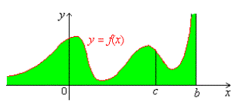

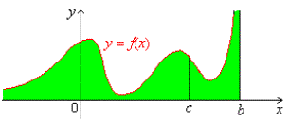


Slide 26

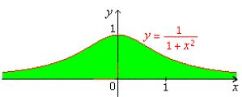




Determine whether or not the integral converges.

Slide 27
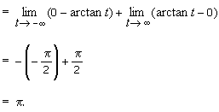

Slide 28
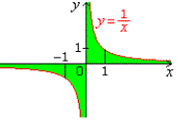




Determine whether the following improper integral converges or diverges. Sketch the graph.

Slide 29



Slide 30

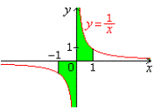
EXAMINING DEFINITE INTEGRALS FOR IMPROPER POINTS
From now on, given a definite integral, we have to examine it for all the improper points. The improper points are +∞, -∞ and the points where the integrand is discontinuous. If we found one or more improper points, we have to treat the integrals improper, and if necessary, break it into basic-type improper intergals before we try to evaluate it.

Slide 31

